Slide 1
Capstone Project-3
Cardiovascular Risk Prediction
(Supervised Machine Learning CLASSIFICATION)
BY
Sk Samim Ali,
Mohd. Izhar,
Sarath Haridas
(Cohort – Florence)

Slide 2

Problem Statement:
The dataset is from an ongoing cardiovascular study on residents of the town of Framingham, Massachusetts.
The classification goal is to predict whether the patient has a 10-year risk of future coronary heart disease(CHD).
The dataset provides the patients information. It includes over approx.4,000 records and 15 attributes. Each attribute is a potential risk factor. There are both demographic, behavioral, and medical risk factors.

Slide 3
Data Collection and Understanding:
Demographic:
Sex: male or female("M" or "F")
Age: Age of the patient(Continuous - Although the recorded ages have been truncated to whole numbers, the concept of age is continuous)
Behavioral:
is_smoking: whether or not the patient is a current smoker ("YES" or "NO")
Cigs Per Day: the number of cigarettes that the person smoked on average in one day(can be considered continuous as one can have any number of cigarettes, even half a cigarette).
Medical( history):
BP Meds: whether or not the patient was on blood pressure medication (Nominal)
Prevalent Stroke: whether or not the patient had previously had a stroke (Nominal)
Prevalent Hyp: whether or not the patient was hypertensive (Nominal)
Diabetes: whether or not the patient had diabetes (Nominal)

Slide 4
Data Collection and Understanding:
Medical( Current):
Tot Chol: total cholesterol level (Continuous)
Sys BP: systolic blood pressure (Continuous)
Dia BP: diastolic blood pressure (Continuous)
BMI: Body Mass Index (Continuous)
Heart Rate : heart rate(Continuous) – In Medical research, variables such as heart rate though in face discrete, yet are considered continuous because of large number of possible values.
Predict Variable(desired target): 10-year risk of coronary heart disease CHD(binary: “1” means “Yes” and “0” means “No”) - DV

Slide 5
Inspecting Dataset:
Used following libraries: NumPy, pandas, seaborn, matplotlib, sklearn, XGboost, imblearn and statsmodule.
The shape of the dataframe is (3390, 17) i.e. 3390 records and 17 columns.
Dropping the id column because it just contains unique id number for each patient and will not be used for prediction.
Missing value count and percent in each column are as follows:
glucose – 304 (8.97%)
education – 87 (2.57%)
BPMeds – 44 (1.30%)
totChol – 38 (1.12%)
cigsPerDay – 22 (0.65%)
BMI – 14 (0.41%)
heartRate – 1 (0.03%)
Replacing the NaN values with median, in all the columns.

Slide 6
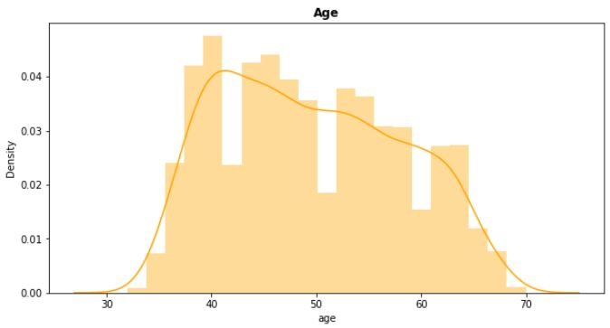
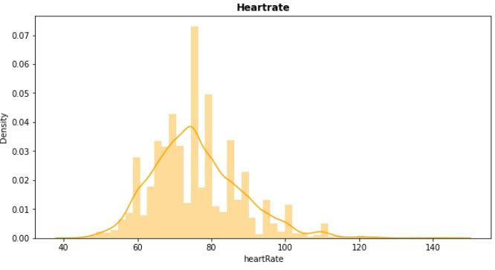
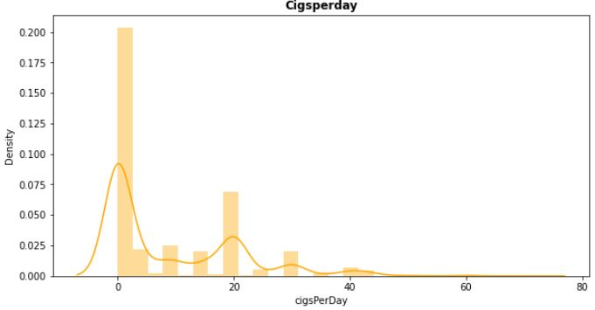
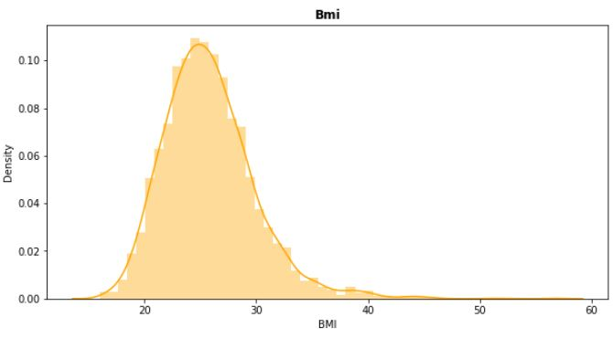
Visualization of Distributions :

Slide 7
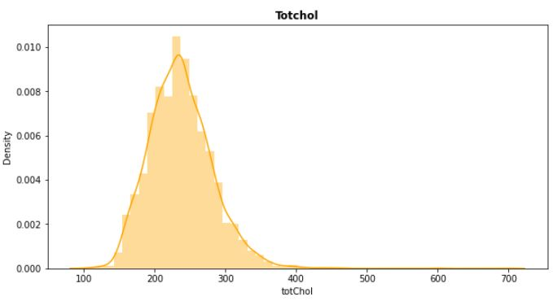
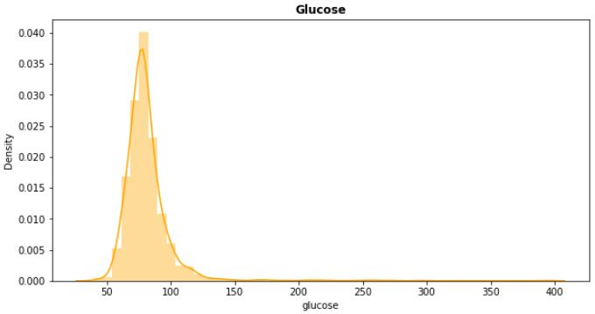
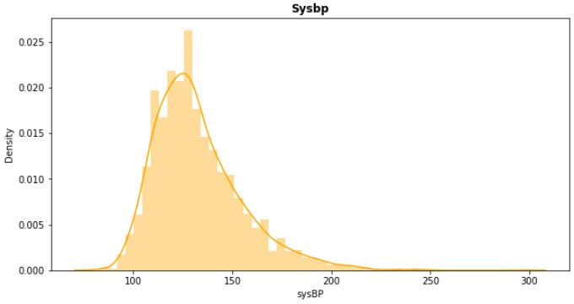
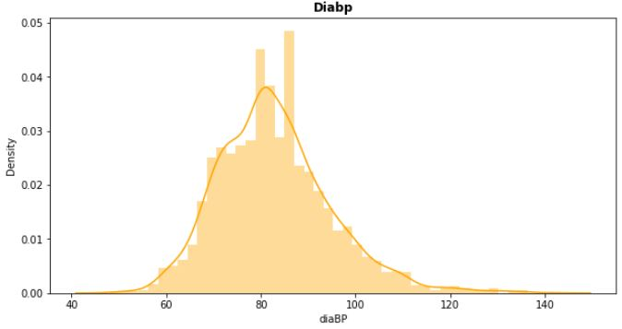
Visualization of Distributions :

Slide 8
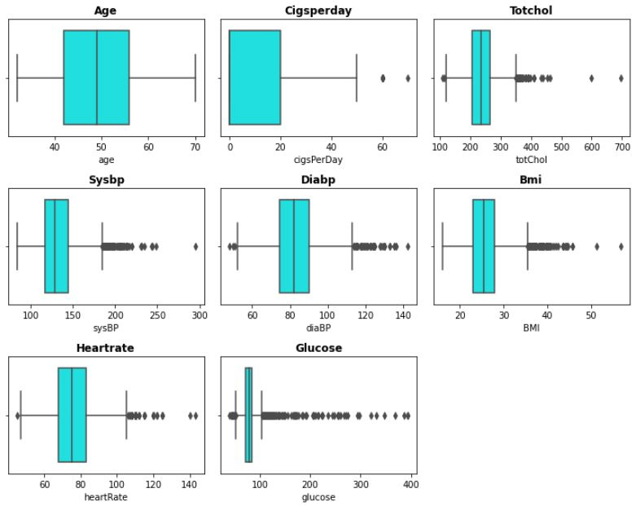
Checking Outliers:
We can clearly see outliers in some columns. So, We treated it by replacing them with the median values.

Slide 9
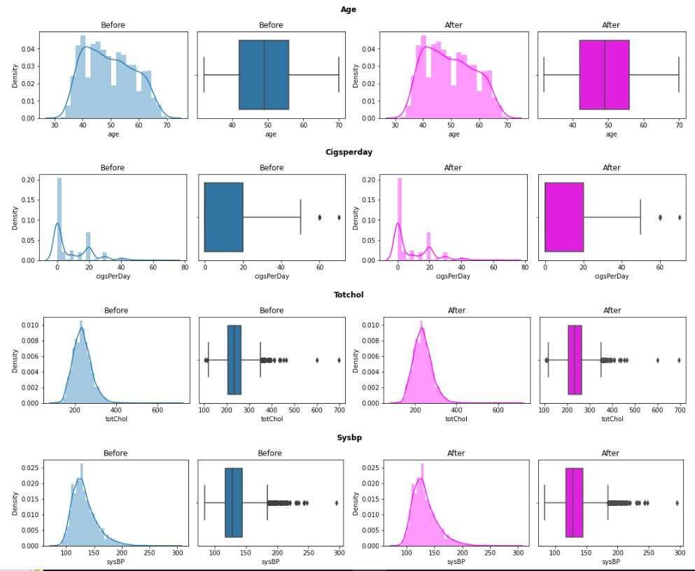
Handling Outliers:

Slide 10
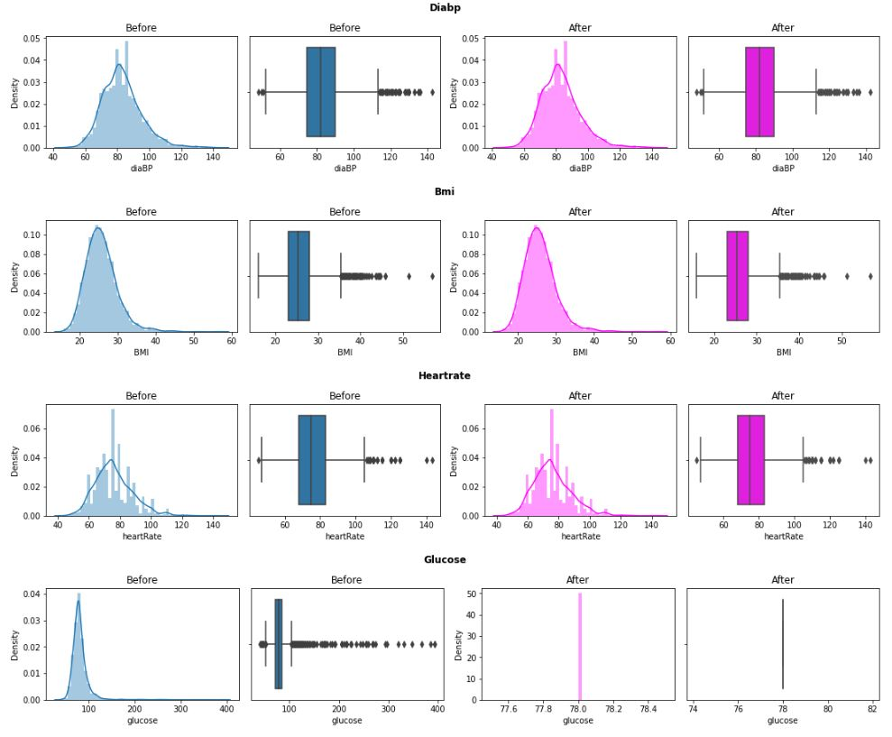
Handling Outliers:

Slide 11
Cleaning and Manipulating the Dataset:
Checking for the duplicates values in the datasets, showed there are no duplicate records in the dataframe.
Checking unique value with their counts in categorical features to define an encoder in order to replace those values with numeric values.
Replaced “M” with 1 and “F” with 0 in the sex column.
Replaced “YES” with 1 and “NO” with 0 in the is_smoking column.

Slide 12
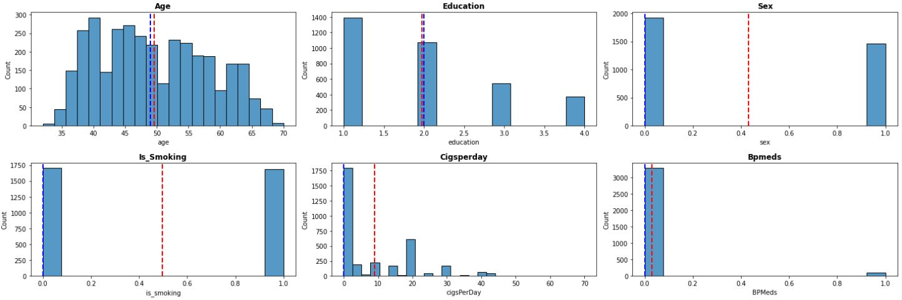
Univariate Analysis:
Univariate analysis is to understand the distribution of values for a single variable. It is used to describe the every single feature. Measure of central tendency means where the mean or median of the dataset is located, measure of dispersion represent how spread out the values are in the datasets including standard deviation and variance.
Red and blue lines in the plot represent the mean and median respectively.

Slide 13
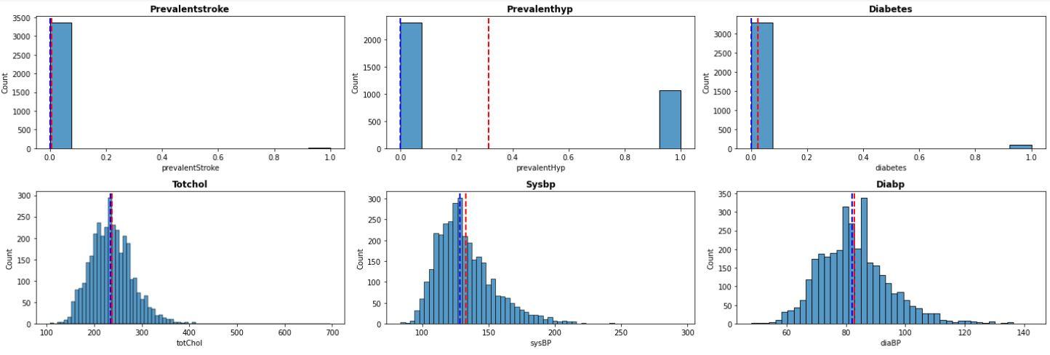
Univariate Analysis:

Slide 14
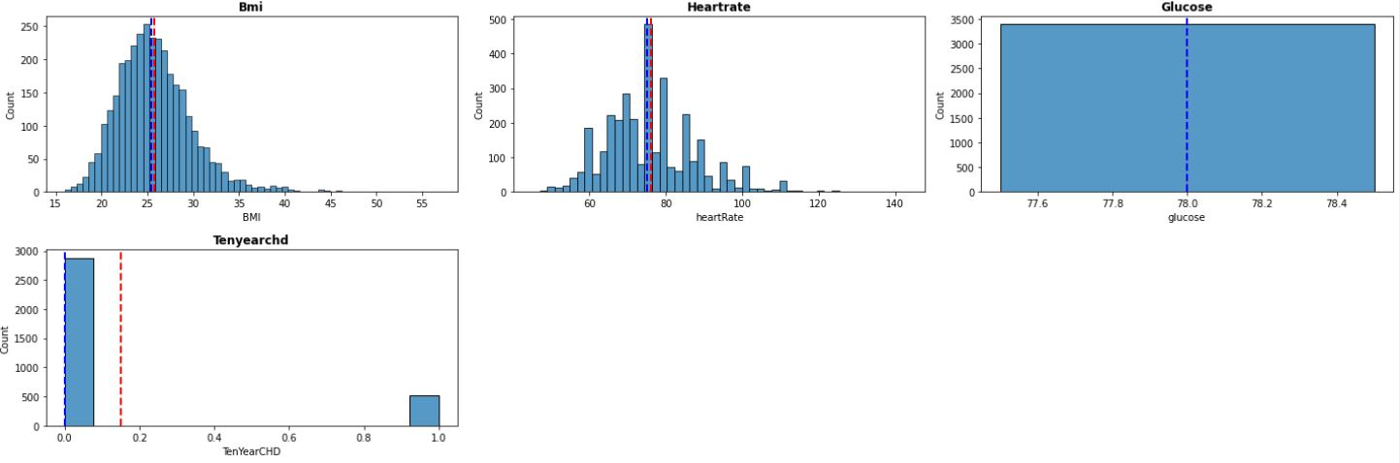
Univariate Analysis:

Slide 15
Univariate Analysis:
Observations:
Most of the people in our dataset are around 40-50 years old.
Data for Female population is more than that of males.
There are equal number of smokers and non smokers in the dataset.
Most people smoke less than 10 cigarettes a day.
Very few people are on blood pressure medication, diabetes and had previously a stroke.
Rest all the feature appear to be normally distributed.
Also in the dataset provided, very few number of people have the risk of Coronary heart Disease. So we will have to deal with the class imbalance problem as well which we will discuss in the later slides.

Slide 16
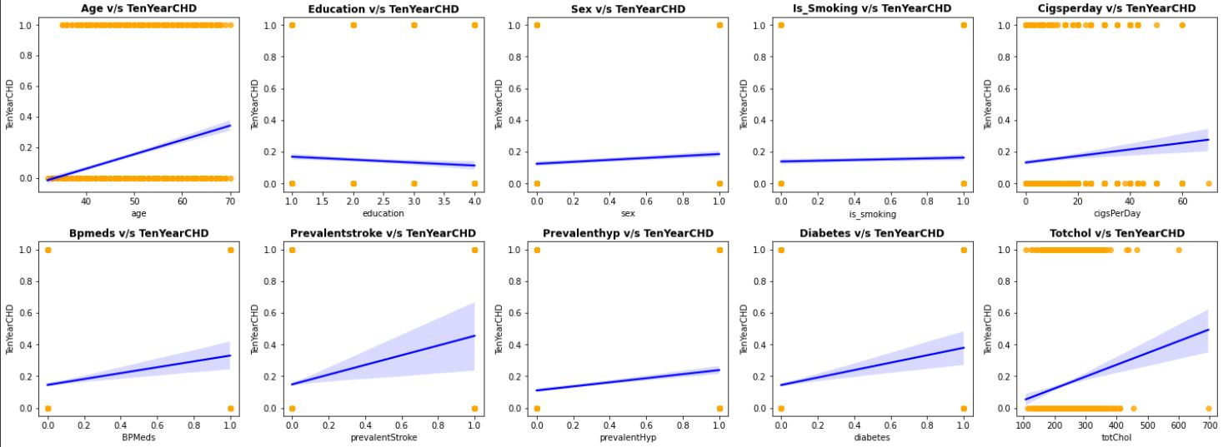
Bivariate Analysis:
In Bivariate analysis we are visualizing the relation between dependent variable and rest of the independent variable.

Slide 17
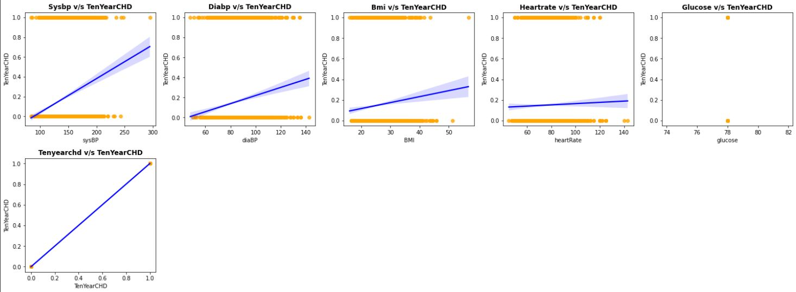
Bivariate Analysis:
From the plots we can see that age, bmi, totchol, sysbp, diabp etc. are having a clear cut positive relation with the dependent variable, whereas rest of the features have nominal association.

Slide 18
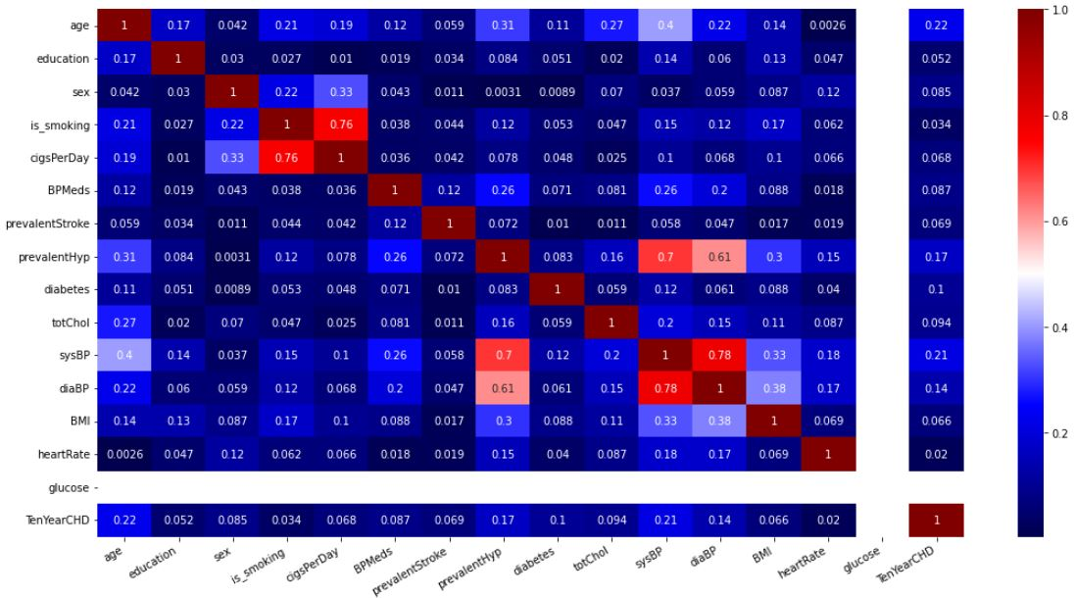
Multivariate Analysis:

Slide 19
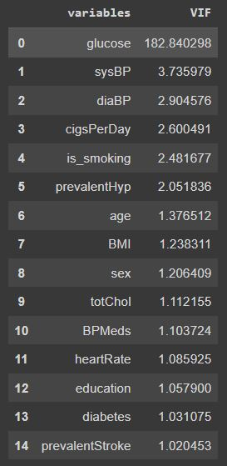
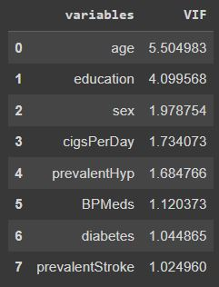
Handling Multicollinearity:
Checking the multicollinearity between all the features, there are some features which are highly correlated with each other like is_smoking and cigsperday and so on.
To handle the multicollinearity we have used VIF score of all independent variable which represents how well the variable is explained by other independent variables.
we have excluded the features whose VIF score is higher than 10. Pictures in the left and right shows the VIF scores of variables before and after multicollinearity treatment.

Slide 20
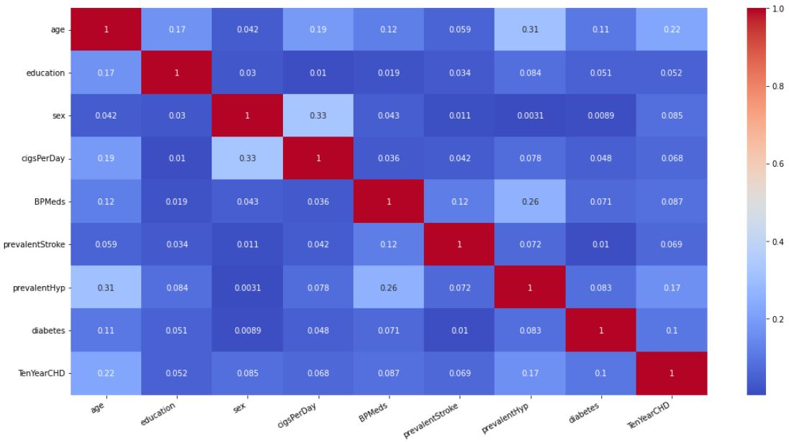
After Handling Multicollinearity (Updated heatmap):

Slide 21
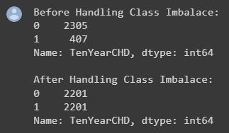
Model Building Prerequisites:
Using Minmax scaler for scaling the features.
Making a variable to define F1 score of class 1 of the target variable so as to use it at the time of hyperparameter tuning because by default Gridsearch will maximize the Macro Average of F1 score for all classes. However we want to maximize the F1 score of class 1.
Defining X and Y variables, and splitting the data in 80-20 ratio as train and test sets.
Handling class imbalance by oversampling using SMOTE followed by removing the Tomek links.
Finally Checking value counts for both classes Before and After handling Class Imbalance.
Defining a function which takes classifier model and train test splits as input and outputs the classification report for model performance on train and test data. Also plots the feature importance.

Slide 22
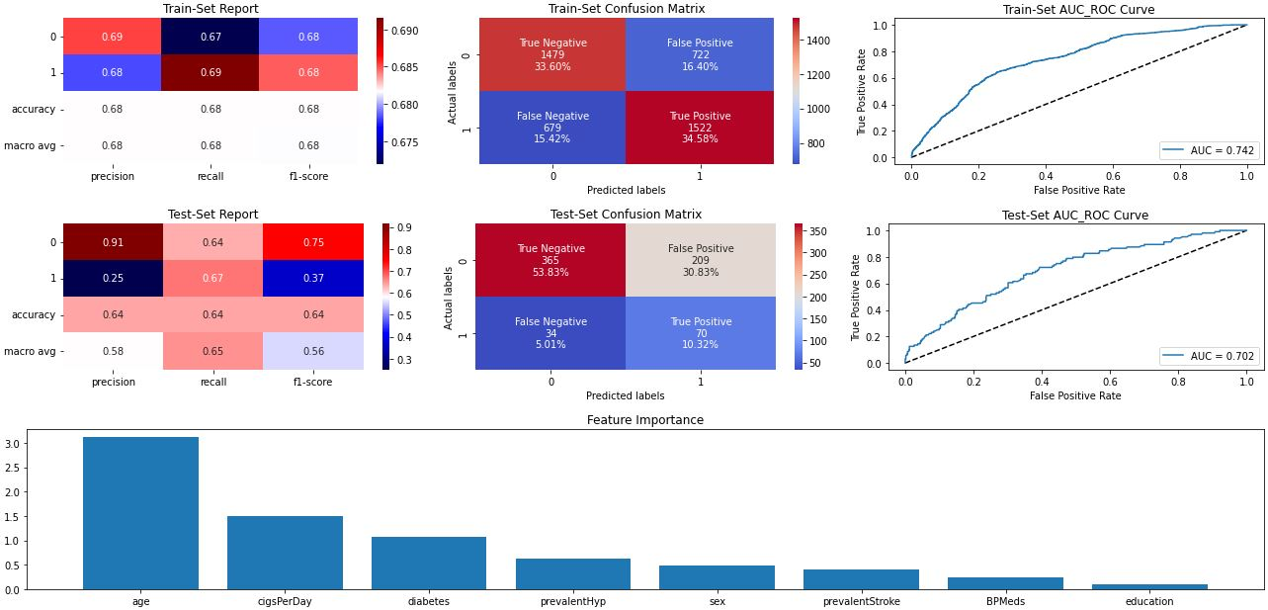
Logistic Regression:

Slide 23
Logistic Regression:
Starting with the quick and dirty models first, then proceeding towards the complex models. Logistic regression outputs following result for class 1 on test data:
Precision - 0.25
Recall – 0.67
F1 Score – 0.37
The feature importance plotted is based on the beta coefficients of z (i.e. before applying sigmoid function).
Age is the most influencing feature, followed by CigsPerDay followed by diabetes.

Slide 24
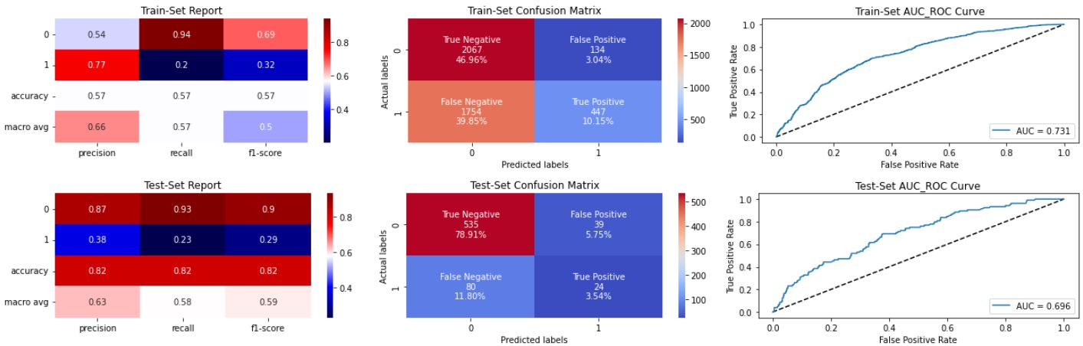
Naïve Bayes Classifier:
Naïve Bayes Classifier is very fast to implement and may be used as a baseline model to compare with different models. It outputs following result for class 1 on test data:
Precision - 0.38
Recall – 0.23
F1 Score – 0.29

Slide 25
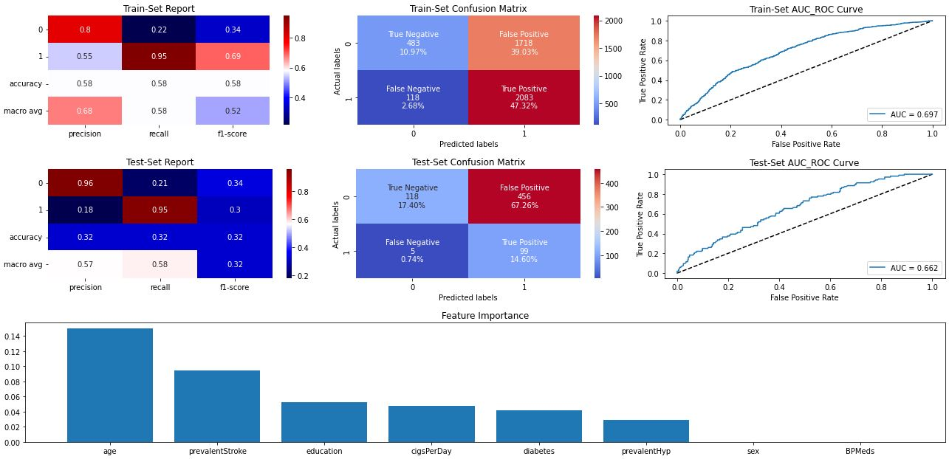
Support Vector Classifier:

Slide 26
Support Vector Classifier:
Support Vector Classifier with C=0.1 outputs following result for class 1 on test data:
Precision - 0.18
Recall – 0.95
F1 Score – 0.3
Age is the most influencing feature, followed by prevalentStroke followed by education.

Slide 27
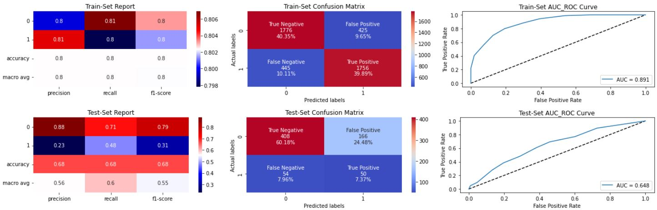
KNN Classifier:
KNeighborsClassifier(metric= 'manhattan’, 'n_neighbors=5) gives following result for class 1 on test data:
Precision - 0.23
Recall – 0.48
F1 Score – 0.31

Slide 28
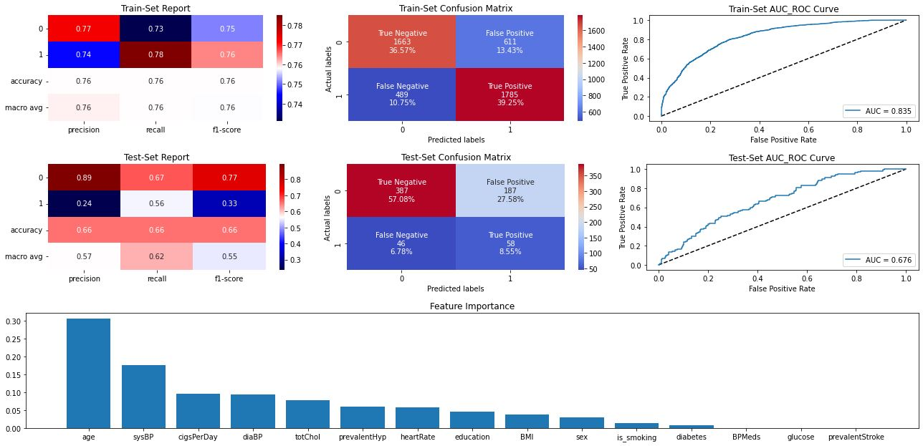
Random Forest Classifier:

Slide 29
Random Forest Classifier:
RandomForestClassifier(max_depth=8, min_samples_leaf=46, min_samples_split=50) gives following result for class 1 on test data:
Precision - 0.24
Recall – 0.56
F1 Score – 0.33
Age followed by sysBP appear to be the feature with high global importance for most of the trees in the RandomForest Ensemble.

Slide 30
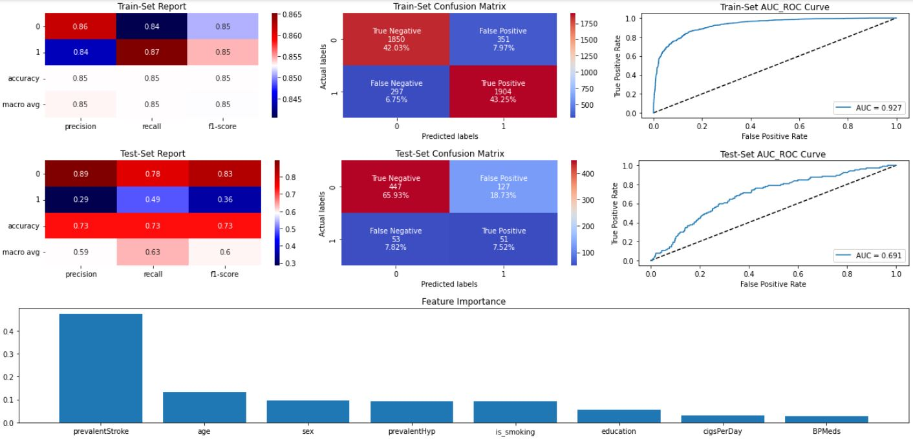
XGBoost Classifier:

Slide 31
XGBoost Classifier:
XGBRFClassifier(eta=0.05, max_depth=10, min_samples_leaf=30, min_samples_split=50, n_estimators=150) gives following result for class 1 on test data:
Precision - 0.29
Recall – 0.49
F1 Score – 0.36
Age and prevalentHyp appear to be the feature with high global importance for most of the trees in the XGBoost tree Ensemble.

Slide 32
Conclusion:
If we want to completely avoid any situations where the patient has heart disease, a high recall is desired. Whereas if we want to avoid treating a patient with no heart diseases a high precision is desired.
Assuming that in our case the patients who were incorrectly classified as suffering from heart disease are equally important since they could be indicative of some other ailment, so we want a balance between precision and recall and a high f1 score is desired.
Since we have added synthetic datapoints to handle the huge class imbalance in training set, the data distribution in train and test are different so the high performance of models in the train set is due to the train-test data distribution mismatch and not due to overfitting.
Best performance of Models on test data based on evaluation metrics for class 1:
Recall - SVC
Precision - Naive Bayes Classifier
F1 Score - Logistic Regression, XGBoost
Accuracy - Naive Bayes Classifier

